Slide 1
Project 2:
Predicting Ames Housing Prices
Team 4: Haziq, Guo Jun, Luka, Nixon, Ram, Saloni

Slide 2

Content
Problem Statement
Background
Model Workflow pt. 1
Data cleaning
Feature engineering
Feature selection
Model Workflow pt. 2
Model Prep
Model fit and evaluation
Model Improvement
Conclusions & Recommendations

Slide 3
Problem Statement
Tendency to focus on price per square foot (or meter) rather than the house as a whole
Our aim:
Identify features that affect housing prices
Build a model that effectively predicts sale prices of house in Ames
Audience: Real estate agents
Notes:
Buyers, sellers and real estate professionals tend to focus too much on price per square foot (or meter) instead
We intend to build a model which can effectively predict housing sale prices. We further intend to identify features that contribute to changes in housing prices so as to equip real estate agents with the knowledge to better advise their clients and improve their sales margin

Slide 4
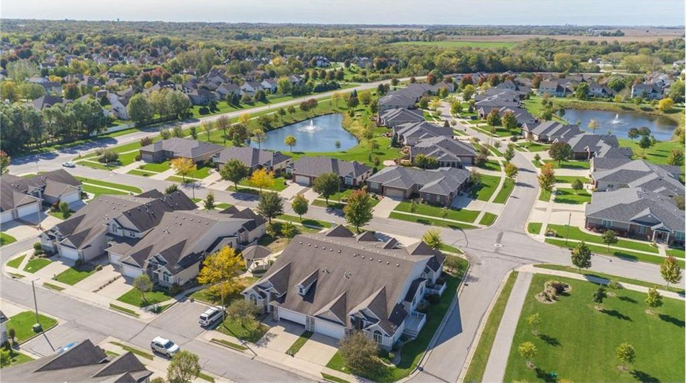
Model based on
2051
residential properties
81
house features
2006-2010
Notes:
Model is based on local data of 2051 residential properties and 81 house features collected from 2006 - 2010 and obtained directly from the Ames Assessor’s Office
“The original data (obtained directly from the Ames Assessor’s Office) is used for tax assessment purposes but lends itself directly to the prediction of home selling prices. The type of information contained in the data is similar to what a typical home buyer would want to know before making a purchase.”
Why is this important? What can we do to improve on this problem?

Slide 5
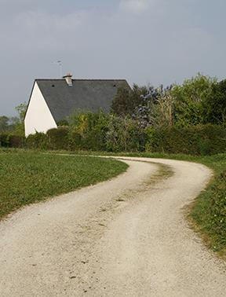
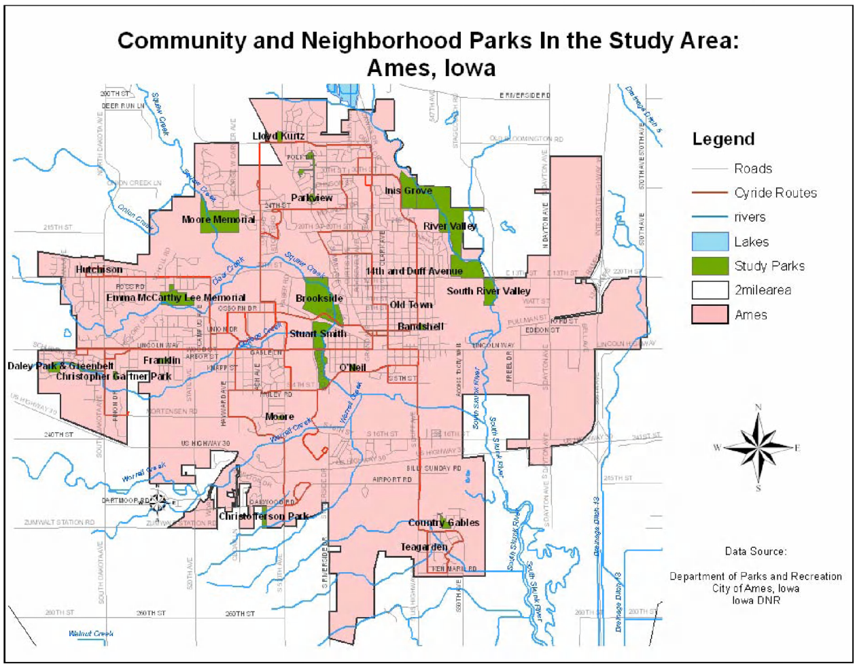
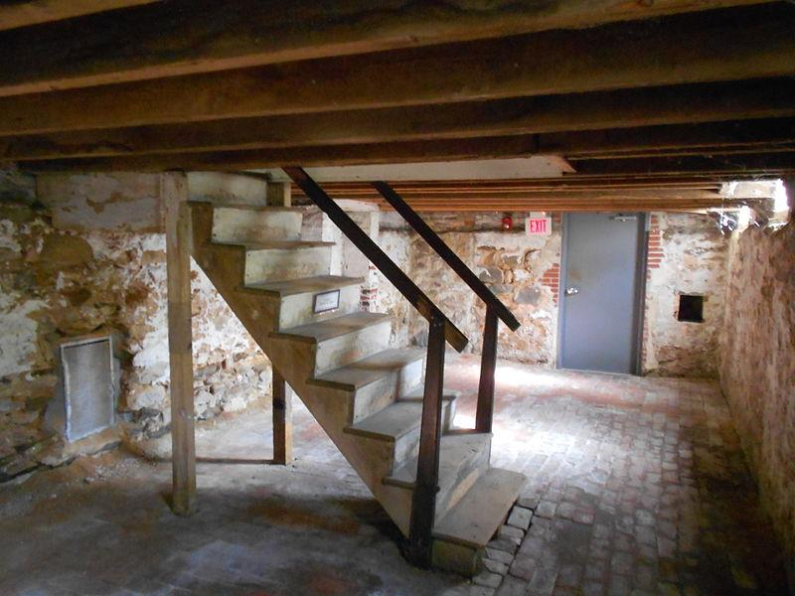

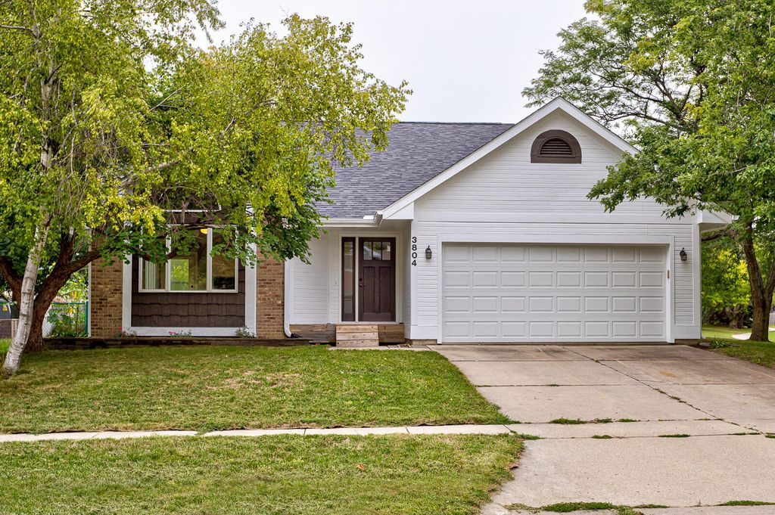
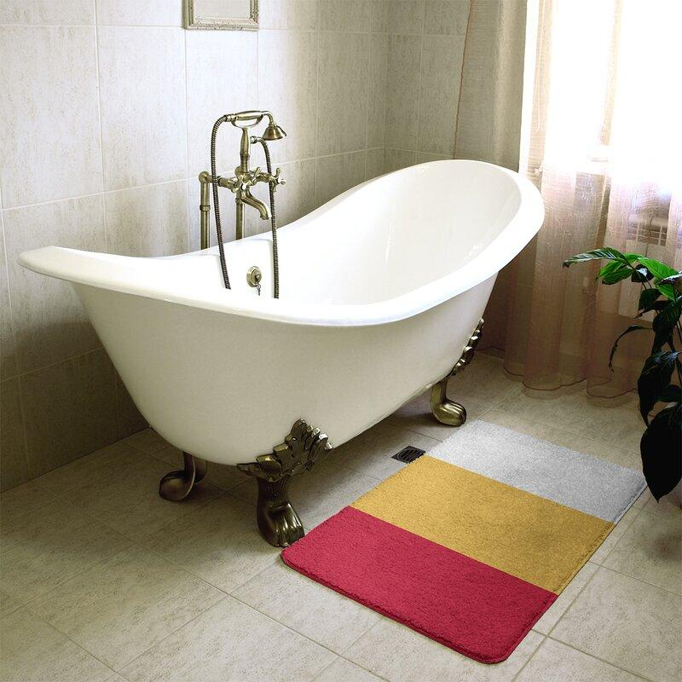
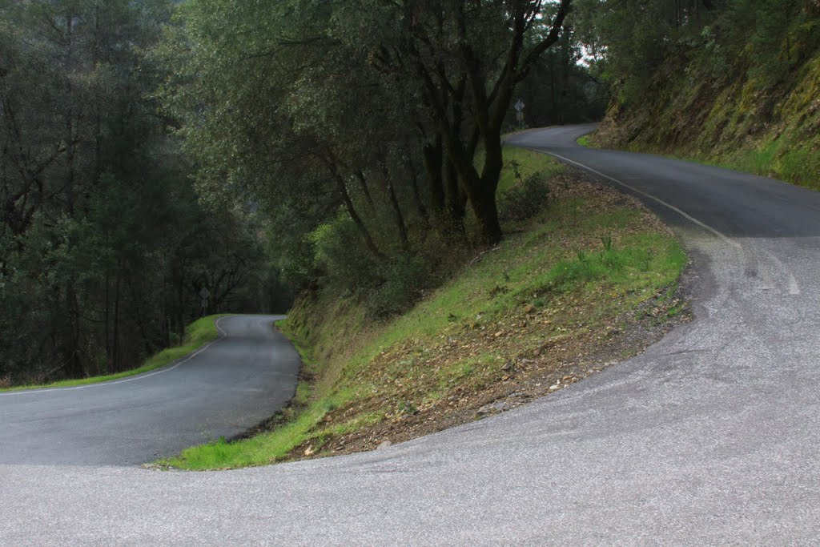
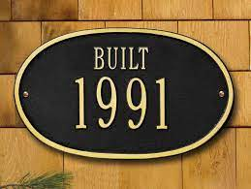
Some features
Notes:
Some features include: neighbourhood, unit age/exterior/garage type/lot frontage, basement area/condition etc etc

Slide 6
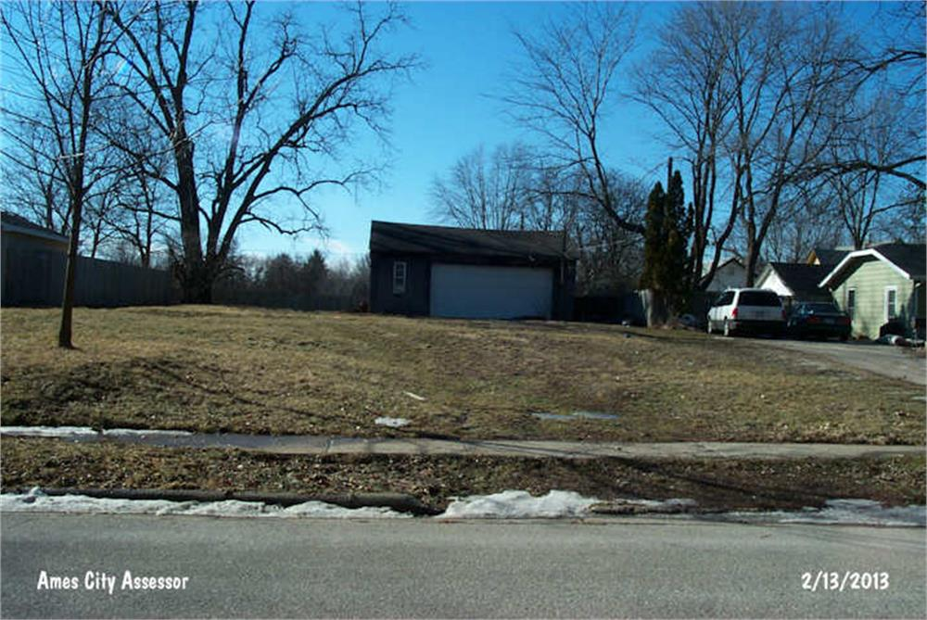
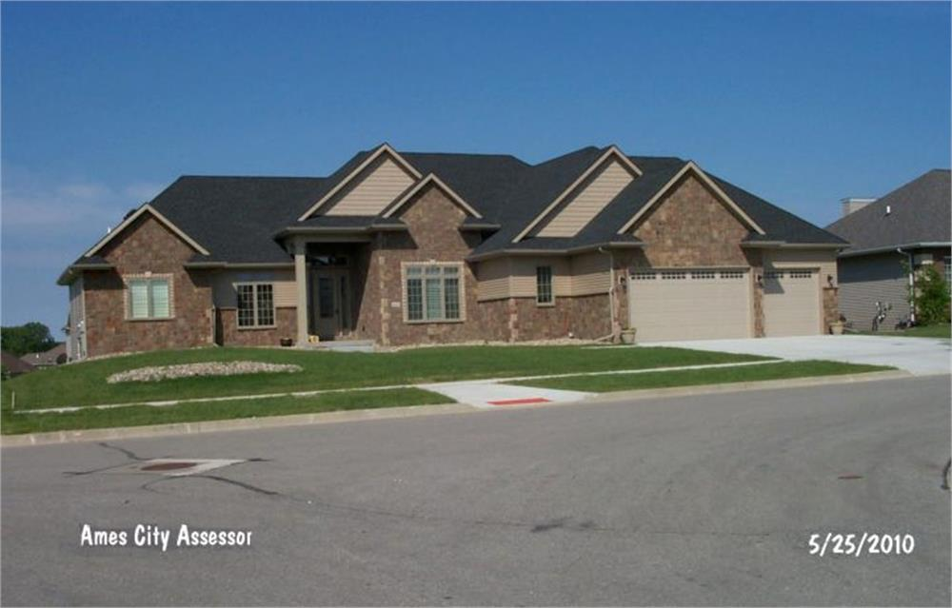
Price
$180,921
Average sale price
$12,789
Cheapest sale
$611,657
Most expensive sale
How much are the houses?
Source: Ames City Assessor

Slide 7
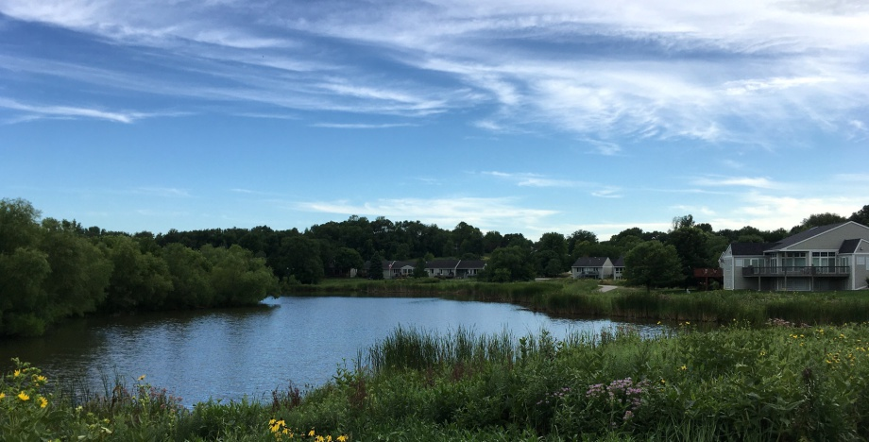
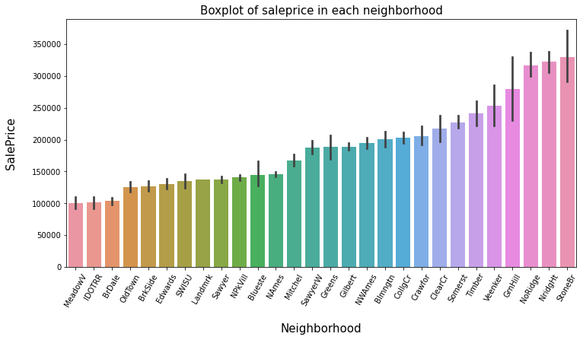
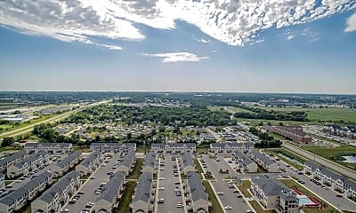
Neighborhood
Stone Brooke
Northridge Height
Northridge
...
28. Meadow Village
Which are the most expensive neighborhoods?
Source:
Remax Property
Rent.com

Slide 8
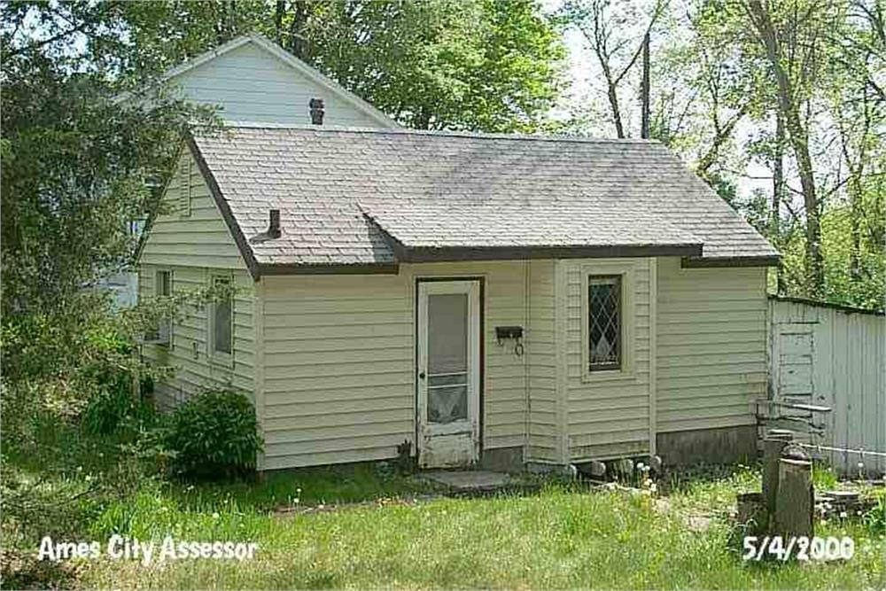
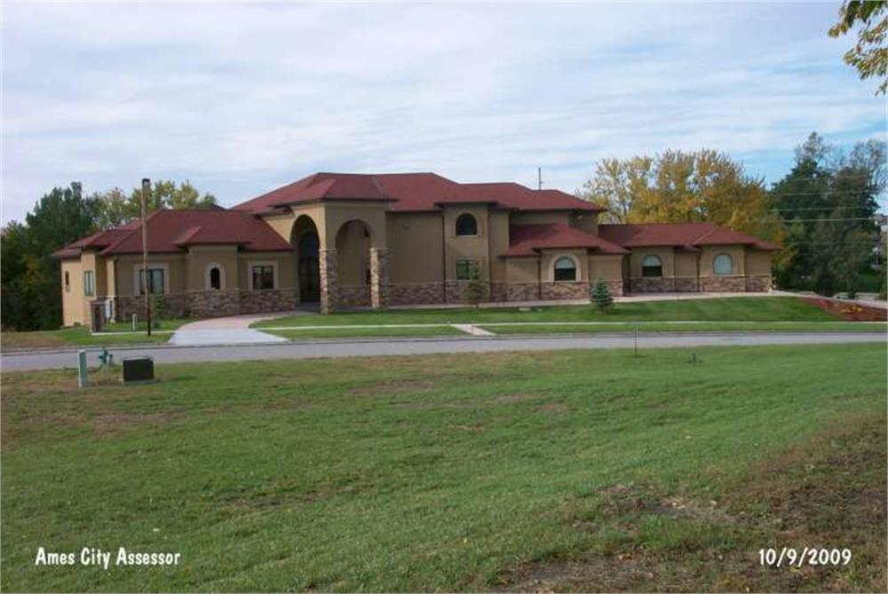
Area
1499
Average area
334
Smallest area
5642
Largest area
How big are the houses?
Source: Ames City Assessor

Slide 9
Model Workflow pt1.
Handling missing values
Handling ordinal and nominal values
Feature engineering
Feature Selection
Identifying and isolating null values
Predicting missing values i.e. Lot frontage
Dropping rows with missing values
Notes:
Before modeling the Ames dataset, it needed to go through some cleaning and feature engineering such that the dataset was complete and functional in predicting Sale Price. The first step was identifying and handling missing or null values.

Slide 10
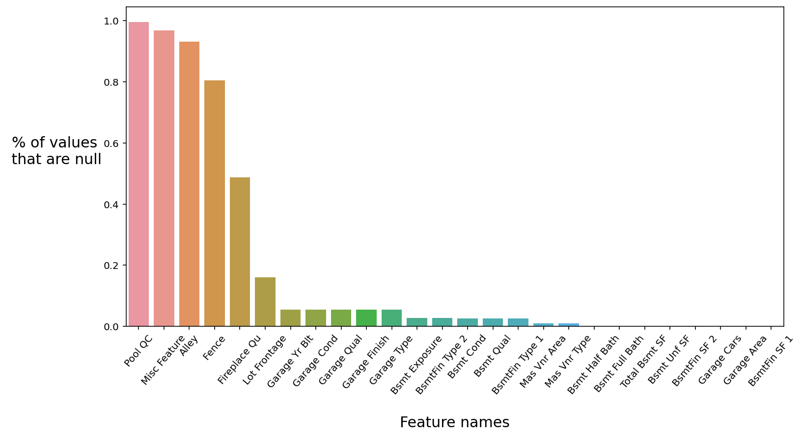
Data cleaning: Handling missing values
Re-labelled some of the null values for categorical variables
Imputation for “Lot Frontage” using the median
Drop remaining null values
Notes:
It’s key to note that not all null values indicate a missing value. Using the data description, we identified that columns such as Pool QC or Misc Feature were ordinal and nominal columns respectively. This meant that “NA” referred to “No Pool” or “None” respectively. So all nominal columns with null values needed to be replaced with the string “None” while all ordinal columns needed null values to be replaced with the integer “0”. Once that was done, columns with continuous variables needed to be checked for missing values. Lot Frontage was identified with having several missing values so we imputed these with the median of the variable. For any other numerical features, rows containing missing values were dropped.

Slide 11
Model Workflow pt1.
Handling missing values
Handling ordinal and nominal values
Feature engineering
Feature Selection
Ordinal values converted to integers
Nominal values dummified
Notes:
Next we had a closer look at ordinal and nominal columns.

Slide 12
Data Cleaning: Ordinal Features
Exter Qual (raw data) |  | Exter Qual (ordinal data)
Ex (Excellent) |  | 5
Gd (Good) |  | 4
TA (Average/Typical) |  | 3
Fa (Fair) |  | 2
Po (Poor) |  | 1
Notes:
Ordinal variables: Categorical variables that have levels between each sub-categories
Method: Replace each sub-category at ascending order with ascending numbers to preserve relationship

Slide 13
Data Cleaning: Nominal Features
Id | Roof Style |  | Id | Roof Style_Flat | Roof Style_Gable | Roof Style_Hip
1 | Flat |  | 1 | 1 | 0 | 0
2 | Gable |  | 2 | 0 | 1 | 0
3 | Gable |  | 3 | 0 | 1 | 0
4 | Hip |  | 4 | 0 | 0 | 1
5 | Gable |  | 5 | 0 | 1 | 0
6 | Flat |  | 6 | 1 | 0 | 0
Dummification
Notes:
Nominal variables, or variables that describe a characteristic using two or more categories are not always useable in their categorical form. Hence they need to be dummy coded.

Slide 14
Model Workflow pt1.
Handling missing values
Handling ordinal and nominal values
Feature engineering
Feature Selection
Combining features
Engineering new features i.e. age, ordinalising neighborhoods
Notes:
So after cleaning the data, the next step would be to conduct feature engineering followed by feature selection. These two steps are essential before we conduct the predictive modelling and I will be presenting them before handing over to Haziq to elaborate more on the modelling.

Slide 15
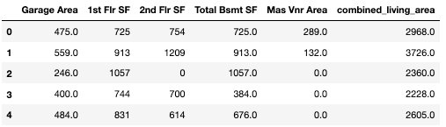
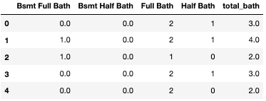
Feature Engineering: Combining Features
Combining features:
1. Garage area + First floor area + Second floor area + Basement floor area + Masonry area = Total house area 2. Total basement bathrooms + Total above grade bathrooms = Total bathrooms
Raw data
Combined feature
Notes:
Feature engineering. For this project, our feature engineering involves 2 important process, feature combination and new feature generation. We do feature combination by combining multiple related features into a single representative one. And the reason we do this is to reduce the number of features. And the reason why we want to reduce the number of features is to reduce the model complexity while still retaining the underlying relationships between the features and the outcome. The outcome in this case is the housing sales price. Here we have two examples. The first one is we combined the garage area, first floor area, second floor area, basement floor area and the masonry area into the total house area. And the second example is where we combine the basement and above grade number of bathrooms into a single feature that represents the total number of bathrooms.

Slide 16
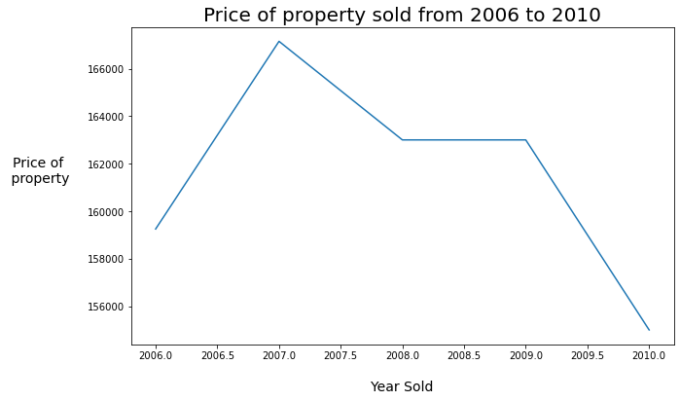
Feature Engineering: Creating New Features
2. Creating new features:
Year Sold - Year Built = Age of the house
Raw data
New feature
Notes:
The next step for feature engineering is to introduce new features from existing data. Here, we created the new feature, the age of the house and we create this by subtracting the year which the house is built and the year where the house is sold.

Slide 17
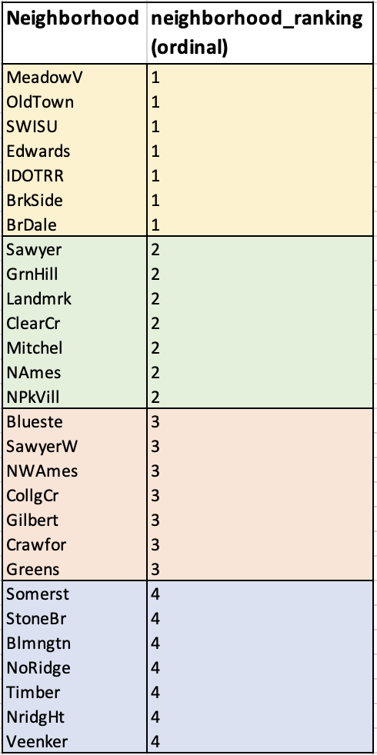
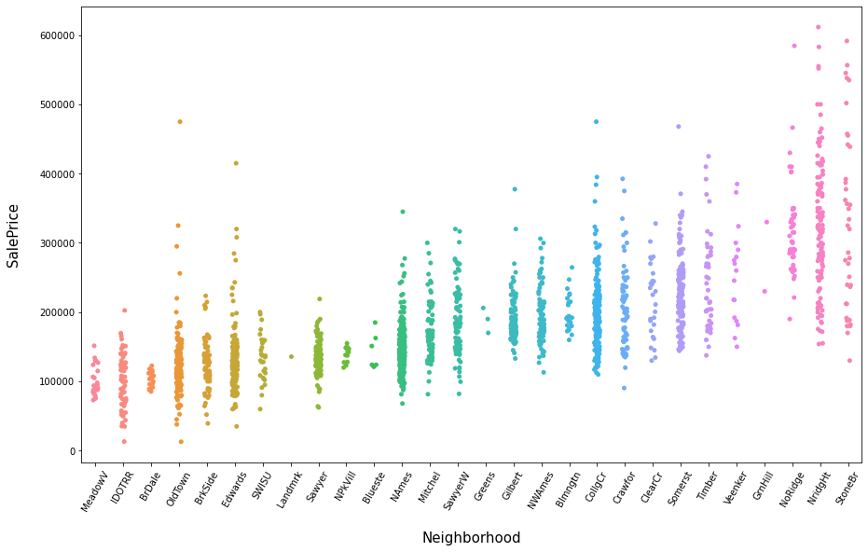
Feature Engineering: Creating New Features
3. Ordinalising Neighbourhoods using Quality/Condition features
Notes:
This is another example of creating a new feature by collapsing the existing groups into a single ordinal column. Originally in the dataset, neighborhood is recorded as a nominal feature. However, further insights can be drawn base on the graph shown below. In this graph, the y-axis is the sale price and the x-axis is the neighborhood. We can see that there seems to be an increasing pattern as we transit from the Meadow neighborhood to the Stonebrook neighborhood. Therefore, we decided to ordinalise the neighborhood into a new feature called neighborhood ranking. We do this, so that our model later can capture this relationship between the price and neighborhood ranking.

Slide 18
Model Workflow pt1.
Handling missing values
Handling ordinal and nominal values
Feature engineering
Feature Selection
Removing features with dominating common values and weak correlation to target feature
Removing intercorrelated variables
Notes:
Now we move on to feature selection. This involves removing features that have dominant values or features that have poor correlations with Sales Price or features that are correlated to each other.

Slide 19
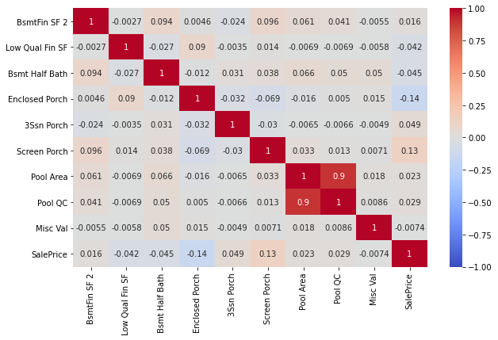
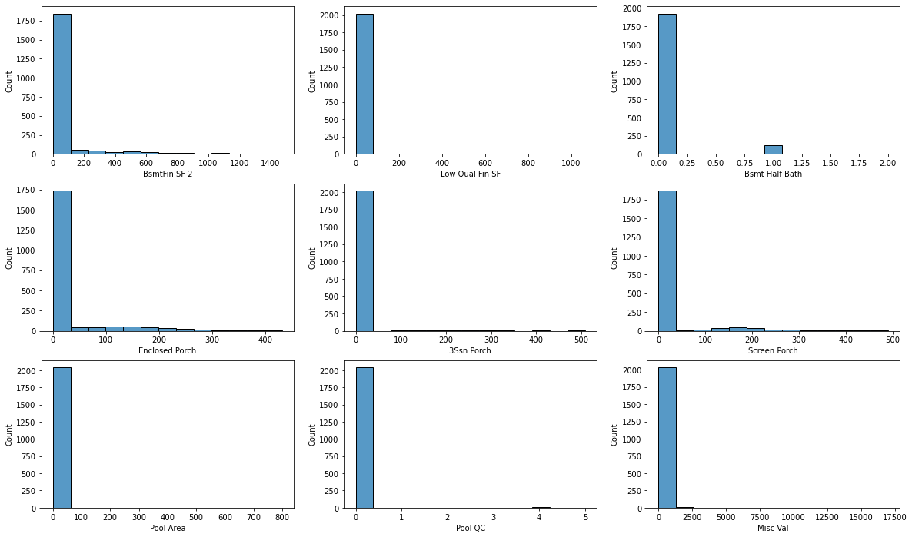
Features Selection
1a. Removing features with 1 dominant value and weak correlation to SalePrice:
Notes:
This slide shows how feature selection is conducted for continuous features. We identified the continuous variables that lacks variation and how we define the lack of variation is the presence of dominant values like the feature examples shown here. For each of this feature shown in the histogram, they are dominated by single value. We set the threshold to be 85%, so any features which is 85% dominated by a single value, we will do a correlation analysis with the sales price, and if the correlation is weak, which is usually the case, we will drop them.

Slide 20
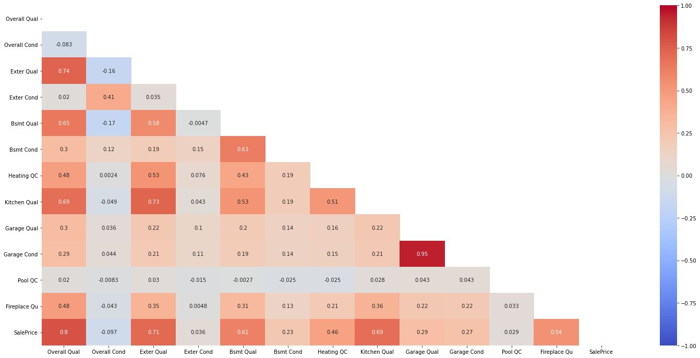
Remove these!

Slide 21
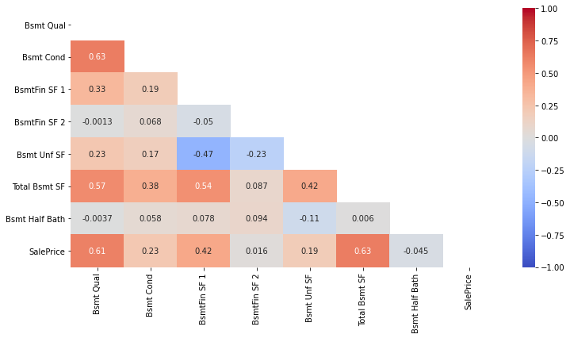
Feature Selection
2. Removing intercorrelated features (‘Basement’ related features)
Remove these!
Notes:
Next, we conduct correlation for the features and sales price. Here we are looking at two things. First, is the intercorrelation of the features. When two features are correlated and sent for modelling, it will result in a multi-collinearity issue. his heat map shows the correlation for the features and the circle shows that high correlation has been detected. So we removed one of those two features. The other thing we want to look at are features that are poorly correlated with sales price and this is indicated by the two purple circles. Their value is very low, like 0.0-something. So we want to remove them because since they are poorly correlated with housing price, they are poor predictors for housing and they have little meaning when modelling except making it more complex.

Slide 22
Model Workflow pt2.
Model Prep & Cross validation
Model selection and evaluation
Model Improvement
Model utilizes 80/20 as train/test data for a robust model
Regression models considered: Linear, Lasso, Ridge

Slide 23
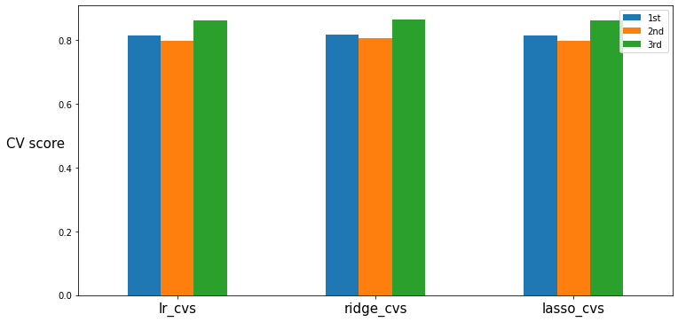
Model Prep
Model | Cross validation score
Linear Regression | [0.815, 0.798, 0.862] mean = 0.825
Ridge | [0.818, 0.806, 0.865] mean = 0.830
Lasso | [0.816, 0.798, 0.862] mean = 0.826
Performed best
Notes:
What is CV - Cross validation. Randomly picking the values and placing them in buckets in order to test the reliability of each of the models used.
These are the scores associated with running cross validation on each of our models used.
The higher the score the more reliable the model

Slide 24
Model Workflow pt2.
Model Prep & Cross validation
Model selection and evaluation
Model Improvement
Regularisation using Ridge and Lasso to avoid overfitting
Ridge Regression identified as best model
Comparison against Null Model (i.e. mean SalePrice)
Model | R² score (Train set) | R² score (Test set) | RMSE
Linear | 0.866 | 0.836 | 31,069
Ridge | 0.861 | 0.842 | 30,507
Lasso | 0.866 | 0.837 | 30,963

Slide 25
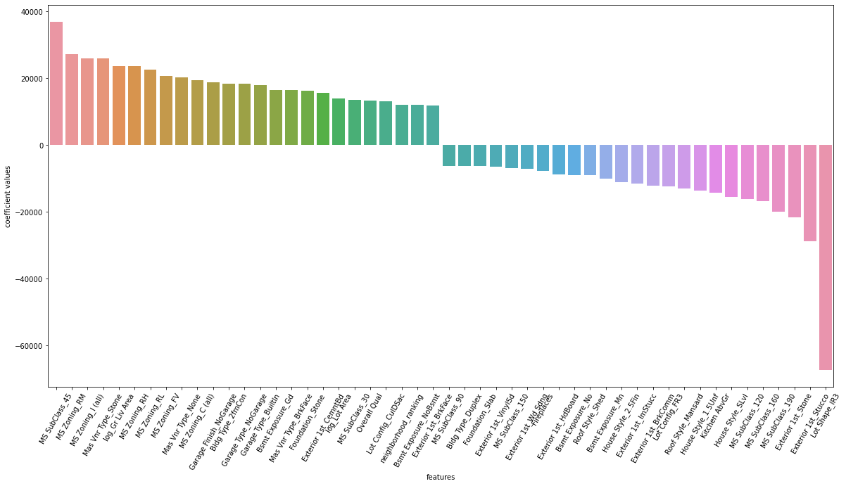
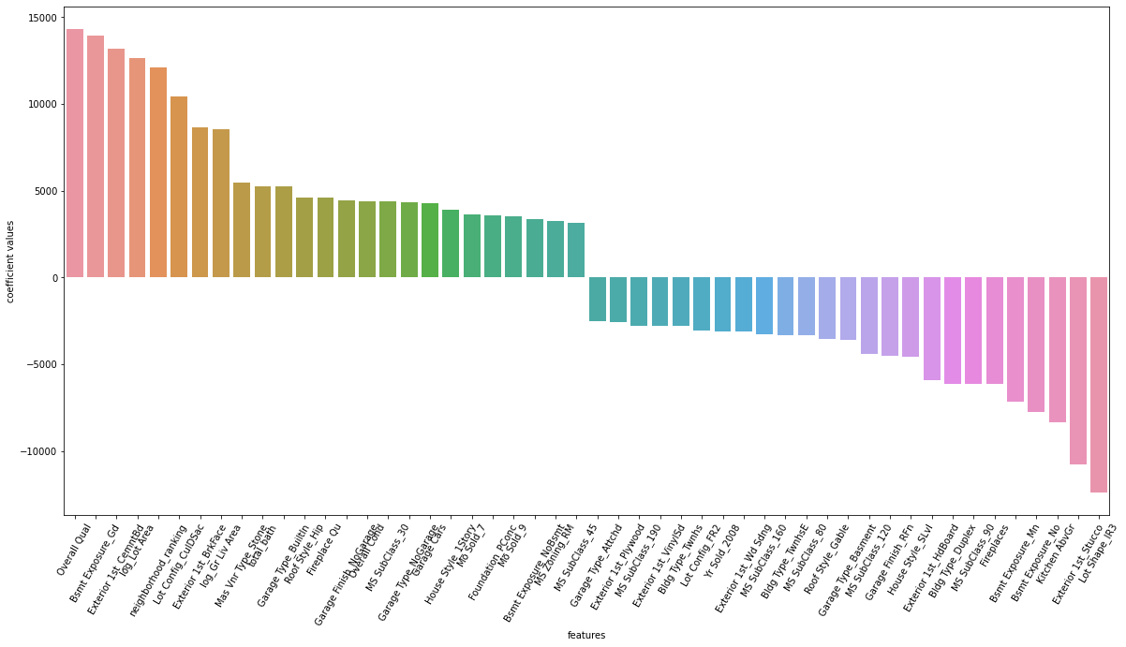
Comparison on coefficient
Linear
Ridge (after regularisation)
Notes:
Here, α (alpha) is the parameter which balances the amount of emphasis given to minimizing RSS vs minimizing sum of square of coefficients

Slide 26
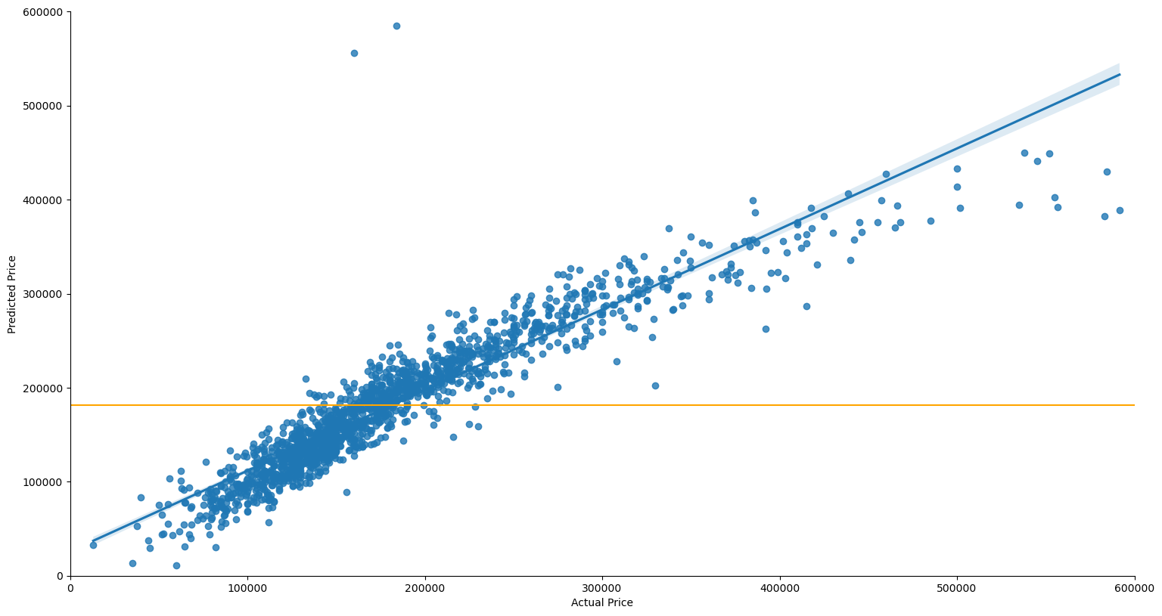
Model Comparison (Train Set)
predicted (ridge regression model)
average (null model)

Slide 27
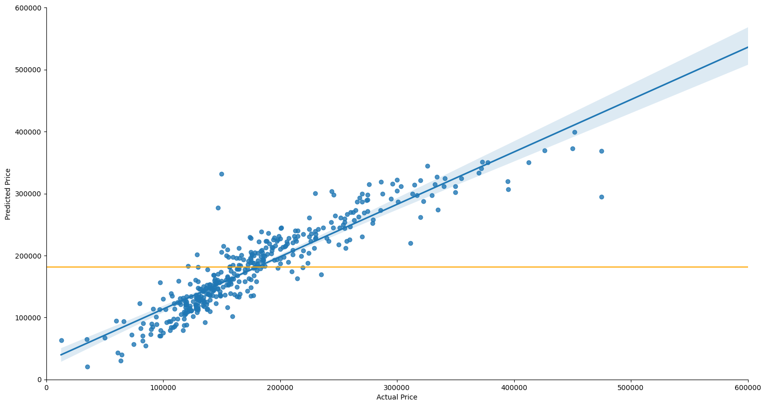
Model Comparison (Test Set)
predicted (ridge regression model)
average (null model)

Slide 28
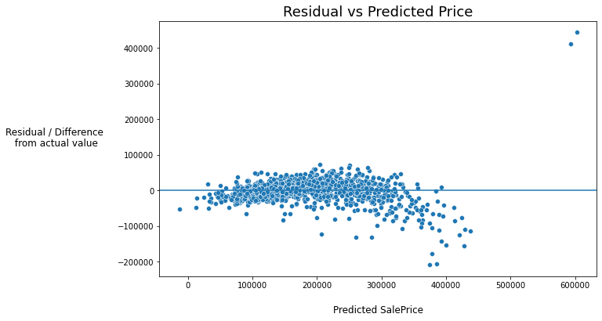
Model Comparison (Residual vs Training Set)
- Residual value
- Robust model
- Outliers kept
Notes:
The goal in our model is to reduce this residual distance to 0 as much as possible.
This shows the train set is robust and is able to give a very good fit to the actual datasets.
You can see the 2 outliers which did not really predict well.
As we all know, the nature of the property market is such that the super rich will be staying in very expensive homes.
However we kept the outliers to reflect the most realistic data as much as possible.

Slide 29
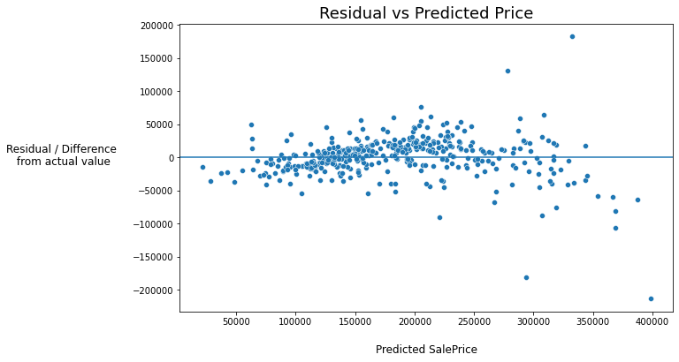
Model Comparison (Residual vs Test Set)
Notes:
This is the test set…..
As a sales agent, when using our model, we will of course tailor to your needs and ensure the model is improved to cater to your area of expertise.
For example, if you are evaluating homes in the average priced neighborhood, you will be assured that our model takes that into account, and such outliers will be taken into account.

Slide 30
Model Workflow pt2.
Model Prep & Cross validation
Model selection and evaluation
Model Improvement
Hyperparameter tuning (alpha = 100)
Logarithmic transformation
Notes:
But our model doesnt stop there, we have plans to further improve it beyond its original state, and in fact we have done many iterations to give you the best possible result. 2 of these improvements are mentioned:
We tuned the hyperparameter to achieve the best model possible.
We adjusted features that did not look properly distributed

Slide 31
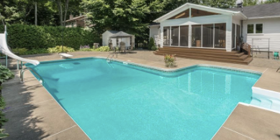

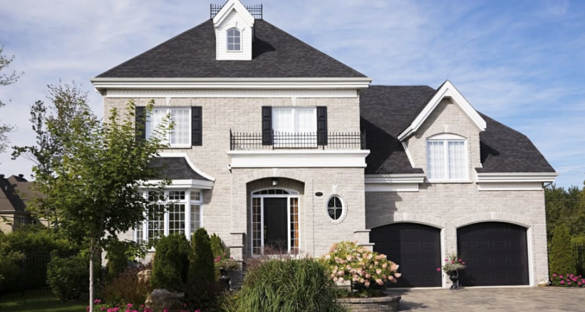
Model Improvement: Hyperparameter (Alpha) Tuning
Model: RidgeCV | R² score (Train set) | R² score (Test set) | RMSE
Alpha = 5 | 0.865 | 0.834 | 30,773
Alpha = 40 | 0.860 | 0.843 | 30,455
Alpha = 100 | 0.855 | 0.844 | 30,370
Alpha = 120 | 0.854 | 0.844 | 30,382
Alpha = 100 ⇒ best compromise for maximum accuracy and minimum error
84.4% of variations can be explained by our model.
Notes:
What is alpha tuning?
It is a model parameter which penalizes how much a feature can impact price.
E.g. let’s say a feature of a house maybe “the size of swimming pool” over-estimates the Saleprice of that house, by tuning the alpha appropriately, we reduce the impact that the swimmingpool size have on the house.
So now the swimming pool impacts the price of house more realistically.
So you will be guaranteed that our model gives a fair price prediction based on multiple features of the house, and not 1 dominating feature. In fact we have up to 38 specific features of the house which our model utilizes
Regularization is used to find the sweet spot between underfitting and overfitting models.
- As a result it is used to minimise bias and variance in models.
- Goal of regularization models is to tune the model coefficients in such a way that you will get more stable model coefficients
- Alpha is a parameter to tune the model or a param that informs model how aggressively you want to penalize for your coefficents
- The higher the alpha, the lower the coefficents (which may not always result in a better model)
- There are two key regularization techniques, each of them aiming at decreasing the size of the coefficients:
- Ridge Regression, which penalizes sum of squared coefficients (L2 penalty).
- Lasso Regression, which penalizes the sum of absolute values of the coefficients (L1 penalty).
- Lasso Regression is more aggressive in reducing coefficients to zero
- As such Lasso can be used as a feature selector as well.
- For example, before running a target model, you can run lasso regression and remove features with coefficent=0 and then run the target model

Slide 32
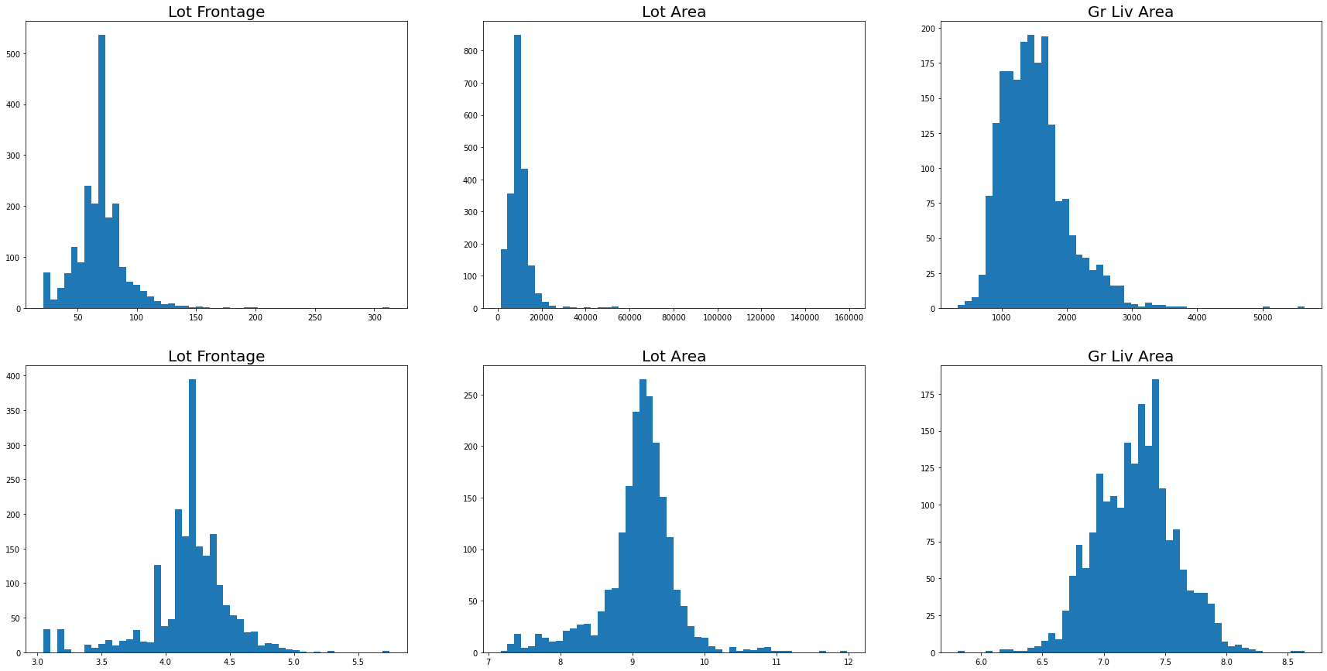
Model Improvement: Logarithmic Transformation
Before
After
Notes:
We looked into areas where there may be skewness in the distribution. Why dont we want skewness?
We want to achieve normal distribution as far as possible, as this will help to improve linearity between house features and the price of the house, and in turn gives our model a more reliable predictor to housing sale price in Ames.
As such we apply log transformation and the model did show improvement in the various metrics.
So our model improves after log transforming.
. It improves linearity between our dependent and independent variables. It boosts validity of our statistical analyses

Slide 33


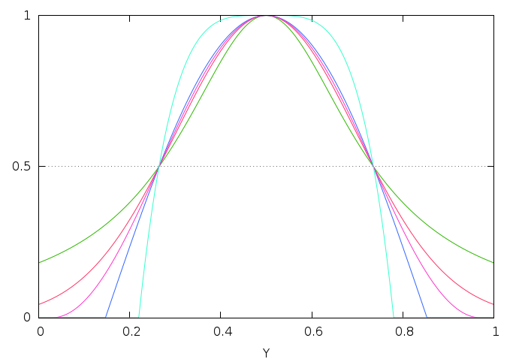
Future Model Optimisation:
Data on family income / per-capita income
Data on average household age
Feature selection technique such as variance thresholding
Notes:
So while our model is ready for you to use, we will assure you that there will be future improvements to this model, to keep in constantly in-line with changes in the regulations or property market in Ames. Some of the improvements we are looking at include the following:
Include data on median income per household
allows for a more targeted prediction for sales agent
Include data on average age per household
there might be differences in how young/old people renovate their homes and these may impact its valuation on buyers.
Further feature selection technique such as variance thresholding which removes features with low variance more systematically, as more data are input in the future
For example if there is a certain regulation in place that requires all homes in Ames to have a certain type of solar panel roof, then this feature can be systematically removed from our model.

Slide 34
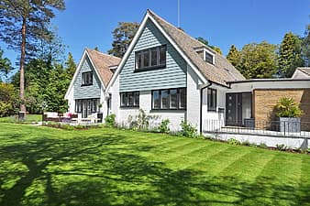


Considerations for Agents
Which features to focus on for higher sale prices and profits
Price ?
Location ?
House ?
Notes:
Why location matters? Physical location means how accessible it is. Whether its accessible by public transport or by car.
Amenities, nearby parks schools shops will lead to more desirable location
Size of the house. Eg one storey, two storey, how many bedrooms
Condition of the house, isit rundown, recently renovated,
Appearance, appealing design,
Price, money talks, higher price, higher profit margins for seller eg. 1%

Slide 35
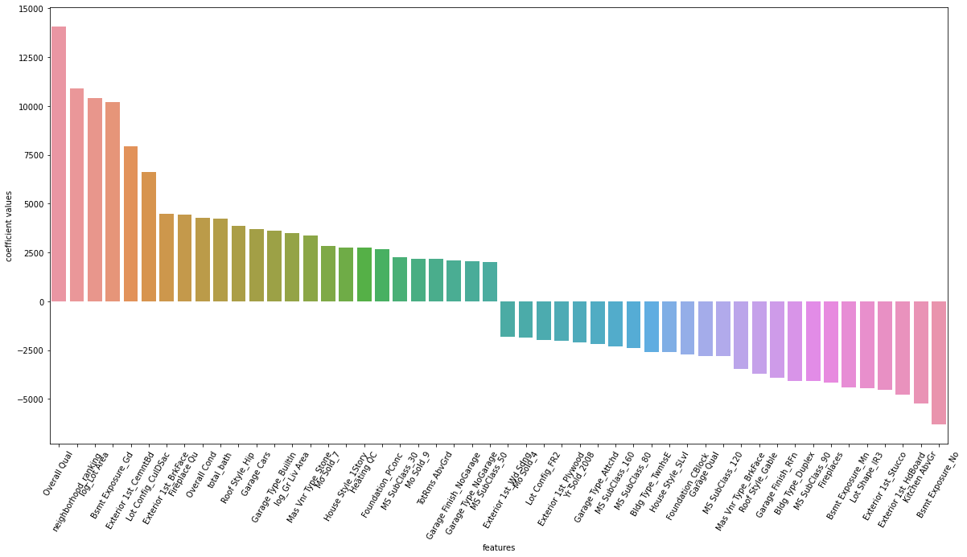
Top 50 House Features
Notes:
How each feature has an impact on the price point.

Slide 36
Bottom 10 Factors
Rank | Feature | Coefficient value
1 | Basement Exposure - No | -6288
2 | Kitchen Above great | -5239
3 | Exterior - Hardboard | -4800
4 | Exterior - Stucco | -4536
5 | Lot shape - irregular | -4469
6 | Basement Exposure- minimum exposure | -4404
7 | Fireplaces | -4185
8 | MS subclass 90 - duplex | -4070
9 | Building type - duplex | -4070
10 | Garage Finish - FN | -3936
Notes:
Fireplaces, might be difficult to maintain, underuse. Costly, fire safety

Slide 37
Avoid these units
Worst
Exterior | Hardboard, Stucco
Lot Shape | Irregular
Building Type | Duplex
Basement Exposure | No, Minimum
Garage Finish | Rough Finished
Notes:
Prefer those units with no garage, top units have no garage
Duplex units are not preferred, due to two units near each other eg noise, proximity, living spaces. Townhouses are more preferred
Basement exposure Refers to walkout or garden level walls, more is better,
Hardboard, poor qualities, due to installation, dry rot. Degrade and not durable/ stucco highly absorbent material. Water causes rot, mold
Unfinished garage are not preferred

Slide 38
Top 10 Factors
Rank | Feature | Coefficient value
1 | Overall Quality | 14050
2 | Neighborhood - ranking | 10892
3 | Lot Area | 10395
4 | Basement Exposure - Good | 10214
5 | Exterior - Cement Board | 7919
6 | Lot Configuration - Cul de Sac | 6623
7 | Exterior - Brickface | 4478
8 | Fireplace Quality | 4417
9 | Overall Condition | 4273
10 | Total bath | 4210
Notes:
Quality- straightforward, better quality cost more
Neighborhood matters, location
Lot area, bigger the size, more pricey it is
BsmtExposure: Refers to walkout or garden level walls - good
Cement board and brickface, why this material?
Cul de sac why this configuration
Overall condition
Types of bathroom matters

Slide 39
Choose these units with features
Specific |  | Generic
Neighborhood | StoneBrook, Northridge | Overall Quality
Basement Exposure | Good | Lot Size
Exterior | Cement, Brickface | Overall Condition
Garage | Built-in | Fireplace Quality
Lot Configuration | Cul de sac
Bath | Total Bath
Notes:
Cul de sac, dead end units. More privacy. Lesser traffic, lesser accidents, lesser crimes. Increses social, kids play area
Bath, fully equipped bathrooms to be more desirable
Cement, durable, brickface, bricks are expensive
BsmtExposure: Refers to walkout or garden level walls - good
No garage

Slide 40

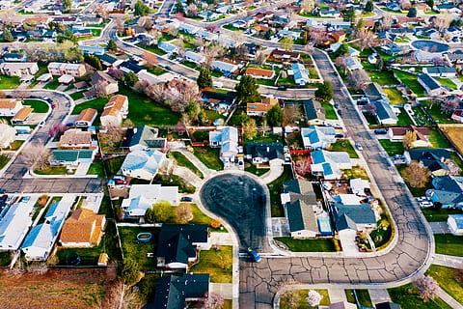

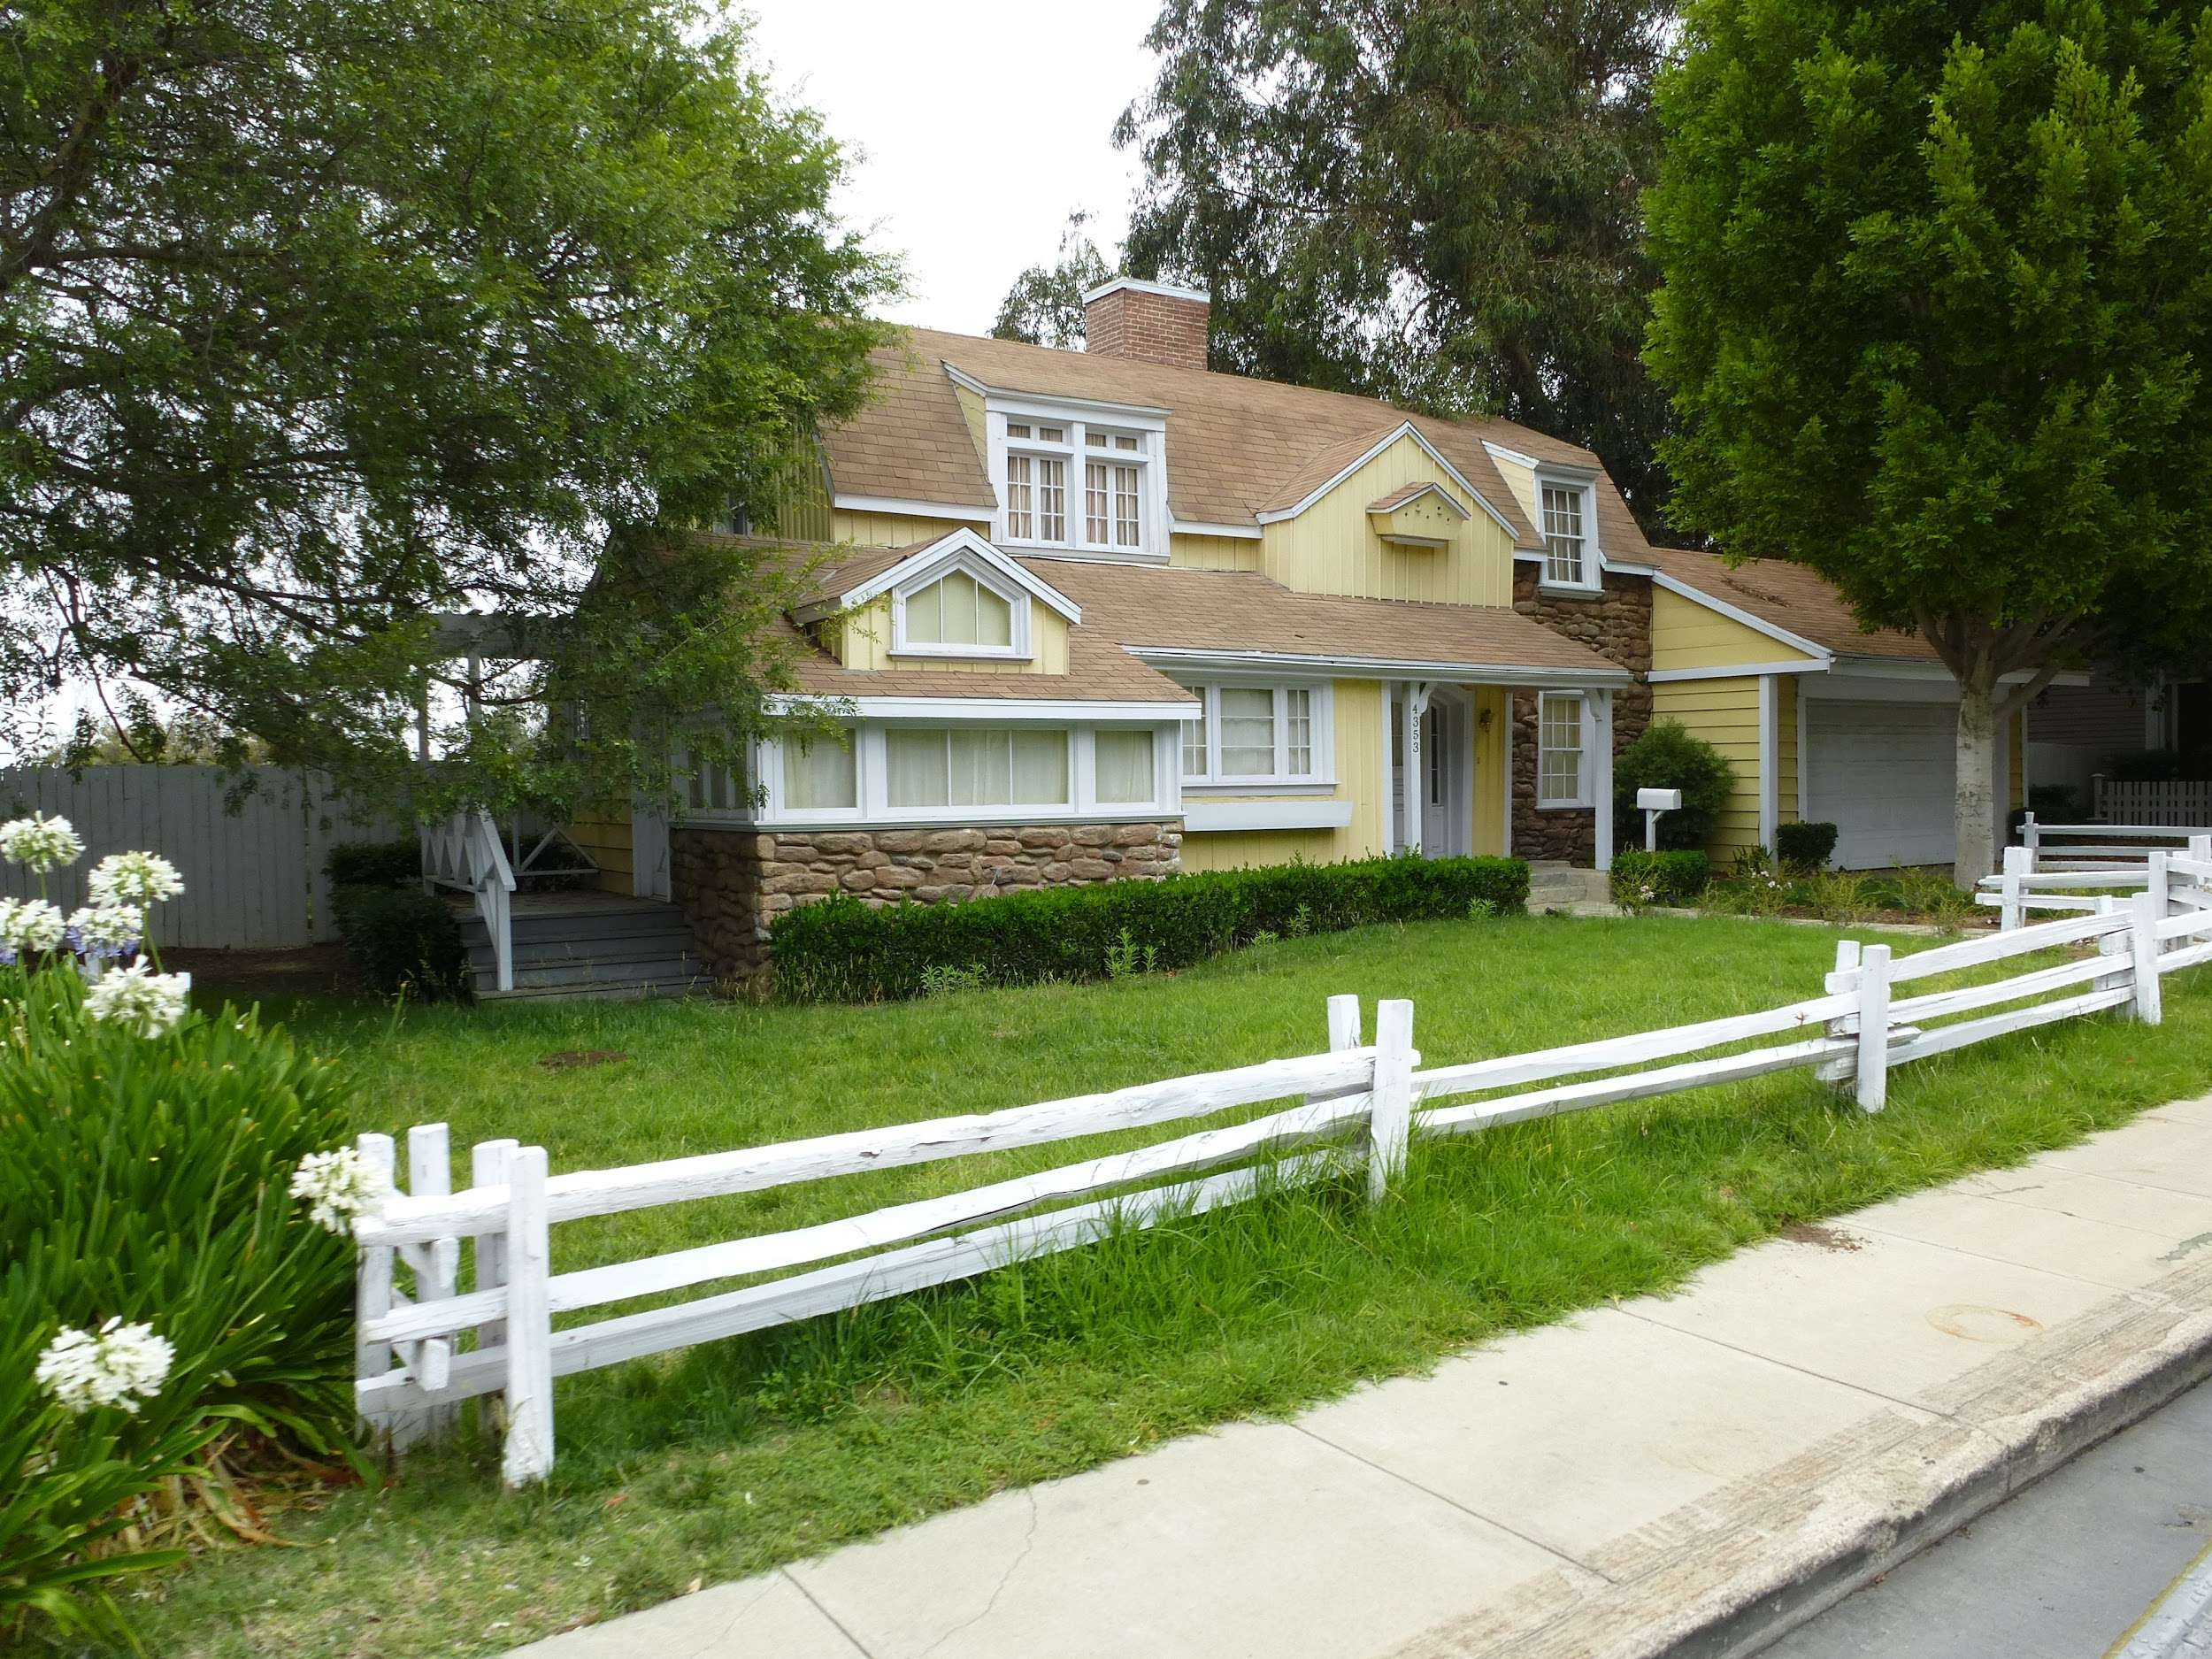
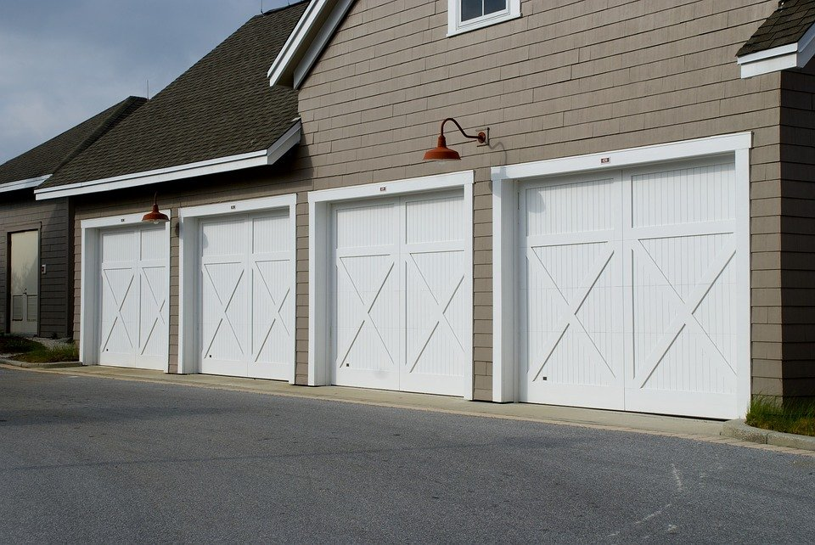


Recommendations
StoneBrook
Cul De Sac ( Dead End)
Notes:
cement/brickface exterior
Garage built in
Full bathrooms
Good fireplace quality, can increase resale value of the home 17C/-12C
Basement quality
Garden level walls,
Generic, size, overall quality, overall condition

Slide 41
Conclusion
Our Approach
Using model to predict sale prices of properties 85% accuracy
Provide real estate agents top performing features to improve prices of houses
Focus on improving worst features in a house to bring up prices

Slide 42
Future Improvements (Why our model?)
Advanced model for price prediction
Shows how features can affect sale price
Can be updated with more features, eg. age of buyer/seller, income of buyer/seller
Able to cater specifically to every income groups
Explore other relationships between features

Slide 43
Thank you

